Slide 1
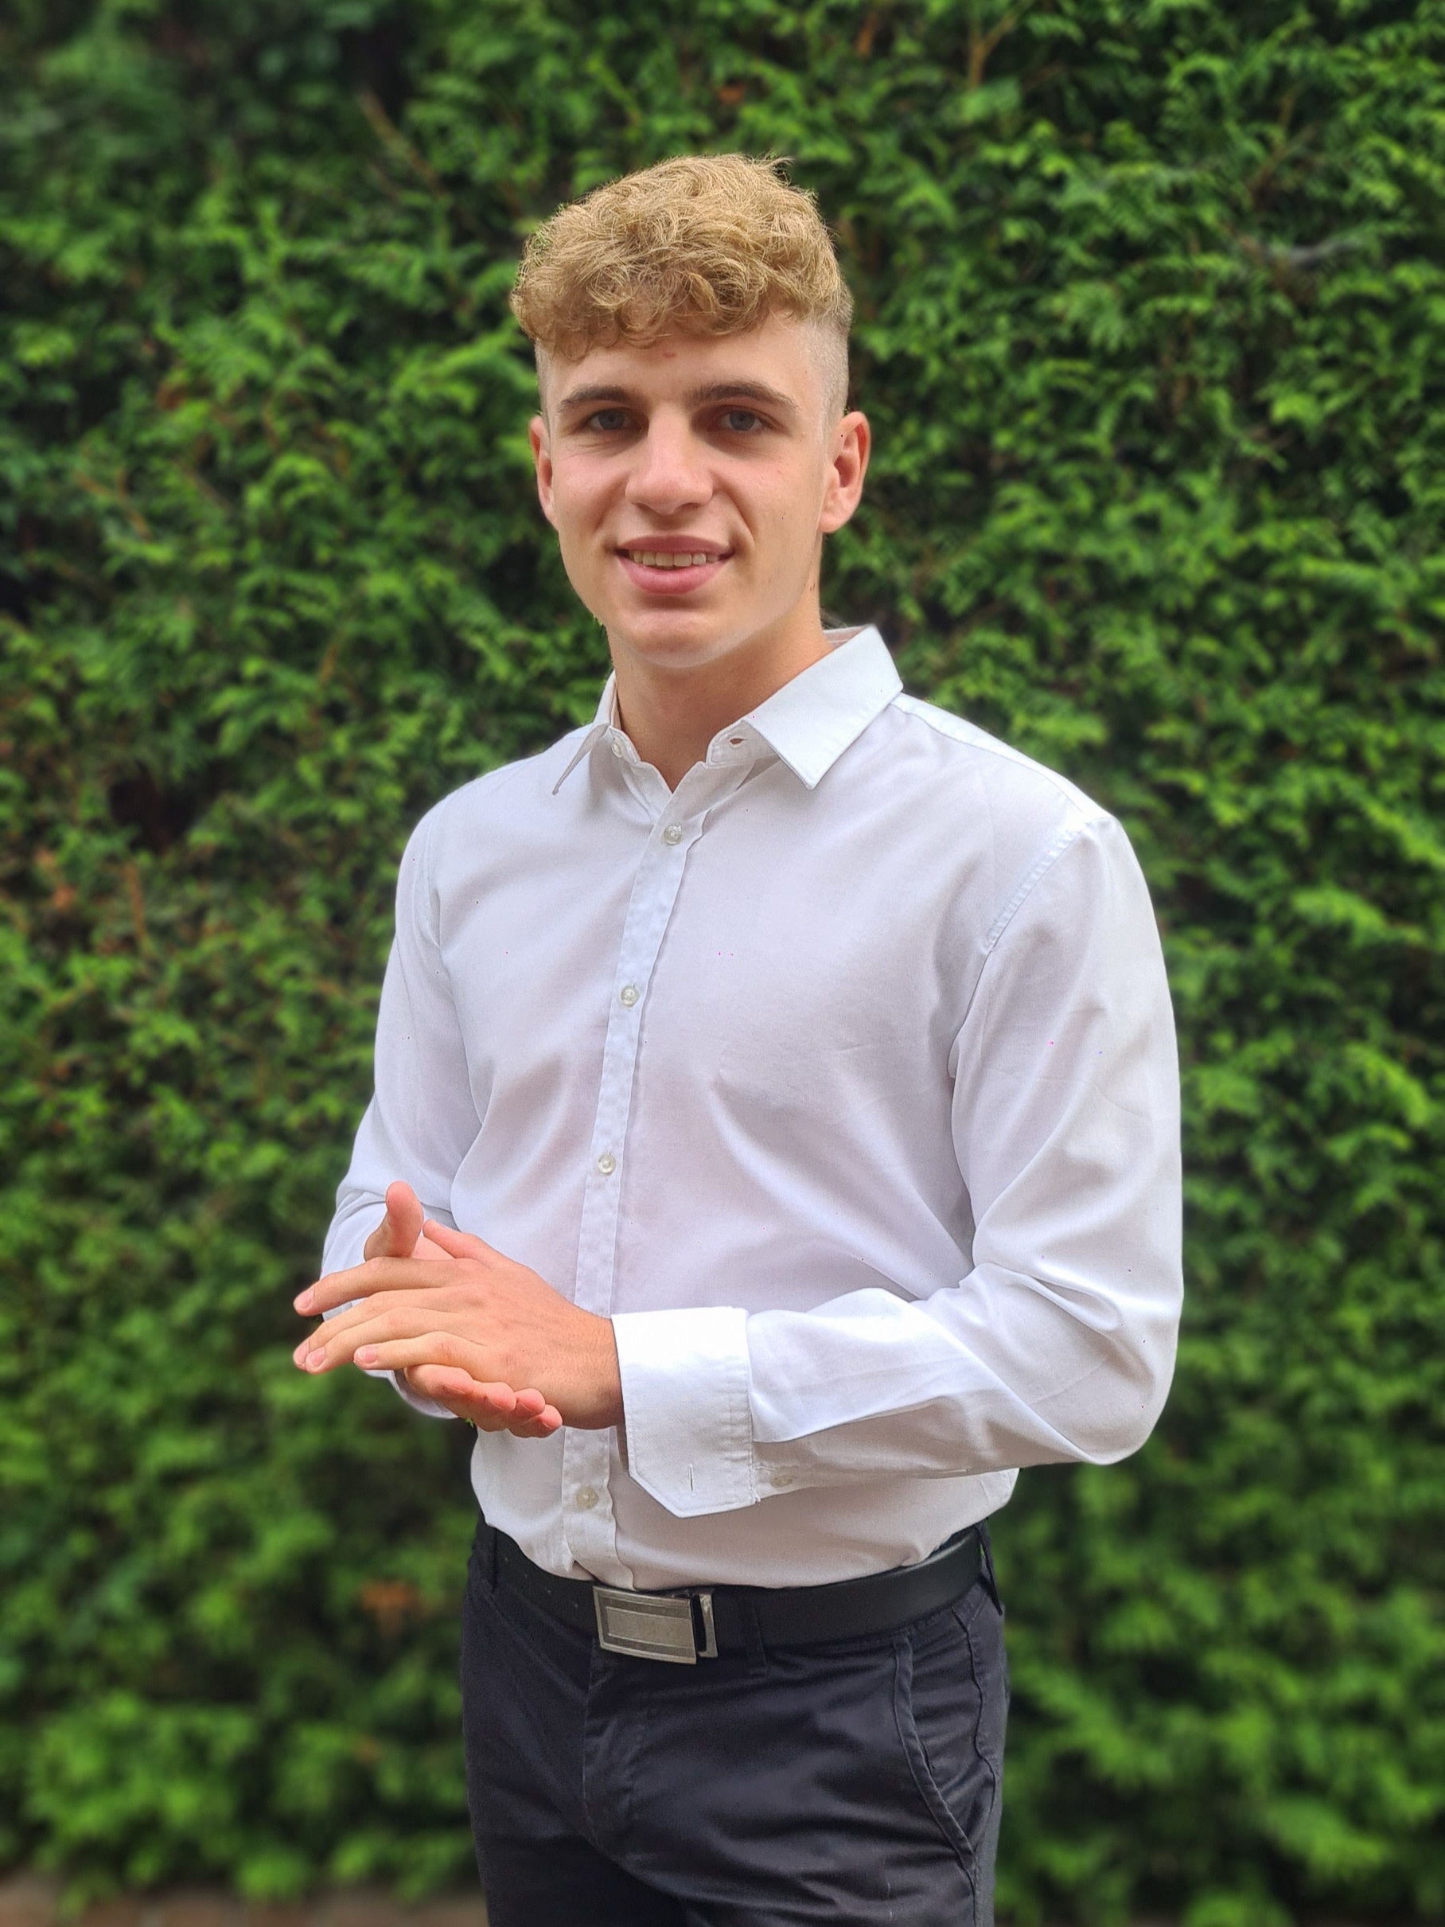
Dominik Szewczyk
224180
[photo]
Learning Log
2023 – 2024 Block C

Slide 2

How To Use
This Template
As a student at Breda University of Applied Sciences studying to become a professional, you are required to provide evidence that demonstrates your professional learning and growth during the block. This template is intended to provide you with a well-structured and organised format for doing this effectively. Keep in mind that certain competencies may require you to update your evidence every week, and others may have only be relevant during a particular week or two.
With the evidence you present here teachers should get a clear and comprehensive overview of your progress, how you’ve engaged with feedback, as well as your general attitude and performance as a student and as an aspiring professional developer.
Note that number and size of text boxes and how they are organized on each slide may be modified as needed. It is up to you to decide what layout is most effective for the content you are providing. You may also add slides if needed, but try to be as economical as possible, i.e. quality over quantity. Focus on the things that are the most significant and meaningful.
You are also free to stylise this template to improve the graphic design and visual appeal, but please remember its purpose: to provide evidence of your progress towards becoming a professional developer. Changes should only enhance and extend the information, and may never subtract. I.e. do not delete anything or change the order of things. If in doubt, seek approval from your teachers!

Slide 3
Learning Log
Structure
Section A - My Plan Must be completed in week 1
Your plan describes your goals for the block. Starting with where you are right now, where do you want to be at the end of the block? I.e. what role(s) will you take responsibility for, and how will you demonstrate progress relevant to the ILOs for this block? What tasks and deliverables are best aligned with your role and the project brief?
Section B - Weekly Log Must be updated every week
This is simply a log (journal) of what you do each day, and what you learn from it. It is your responsibility to update this regularly and frequently. Be sure to include working links to any specific evidence you are referencing (and make sure that you share your docs with the teaching team). Note: some of the required information may be captured in production documents such as your work log or peer reviews.
In such cases, you simply need to provide links to those artifacts and may include any explanatory comment or reflection you feel is appropriate.
(Some reflection is almost always a good idea as it provides the foundation for Section D.)
Section C - ILO’s Must be completed in week 8, but should be updated regularly.
This is where you link your evidence to each of the Intended Learning Outcomes of this block.
Section D - Reflection Must be completed in week 8
Summative reflection on your progress during the block including a critical assessment of everything you did and learned during the block. This is a comprehensive review of everything recorded in Section B, evaluated against the goals and planning laid out in Section A.
Section A
Starting this block
Goals
Section B
Week log section
Section C
ILO section
Section D
Block reflection

Slide 4
Section A
The student sets ambitious, S.M.A.R.T./ C.L.E.A.R goals in alignment with the project brief, their chosen role(s), content of the assessment rubric and their personal long-term goals
A
Goal Setting
Notes:
MUST BE UPDATED EVERY WEEK
This is simply a log (journal) of what you do each day, and what you learn from it. It is your responsibility to update this regularly and frequently. Be sure to include working links to any specific evidence you are referencing (and make sure that you share your docs with the teaching team). Note: some of the required information may be captured in production documents such as your work log or peer reviews.
In such cases, you simply need to provide links to those artifacts and may include any explanatory comment or reflection you feel is appropriate.
(Some reflection is almost always a good idea as it provides the foundation for Section C.)

Slide 5
A
Where am I starting?
1/2
6.8
Feedback from previous assessment
Previous block’s grade:
Please put the evidence links in each section rather than on the next slide this helps identify which link is for which level of the ILO. Overall a solid performance and probably would have been even better if you had been able to devote more time to the robotics portion.
My interpretation / key takeaways
Feedback highlights the need for better time management and attention to detail. I must allocate time evenly across all sections and place evidence links within relevant sections. This will improve overall performance in future assessments.
Notes:
Copy and paste the feedback from the previous block’s assessment into the text box.
Copy and paste the bullet points you listed on the “Lessons Learned” page in section C of your last block’s log.
Compare the grade you gave yourself with the grade you received, and reevaluate or restate your feeling on your current level of progress.

Slide 6
A
What is my plan?
2/2
What I learned last block.
6.8
Last block, I delved into CV, reinforcement learning, and robotics. I developed an ML model for image-based root prediction, employing CV for detection and measurement. Exploring reinforcement learning, I enabled robots to navigate and dispense liquid at target points. Additionally, I implemented a PID controller for similar tasks.
My current level of progress
My current level of progress showcases substantial growth across various domains. I possess a strong command of exploratory data analysis (EDA) and proficiency in machine learning, encompassing supervised learning and hyperparameter optimization. Proficient in Python, I excel in building deep learning image classifiers using Keras. Additionally, adept in Power BI for data visualization, I navigate the Scrum framework adeptly for streamlined project management. Moreover, my insights into ethical AI implementation emphasize responsible and conscientious AI applications. Furthermore, I've recently acquired valuable skills in conducting research and programming in R, expanding my skills in data analysis and research methodologies. Alongside, I gained knowledge in computer vision, reinforcement learning, and basics of robotics, enriching my expertise in diverse areas of artificial intelligence.
Previous block’s grade
Links
2022-2023 Projects: https://github.com/DominikSzewczyk224180/Projects-2022-2023
2023-2024 Projects: https://github.com/DominikSzewczyk224180/Projects-2023-2024
LinkedIn account: https://www.linkedin.com/in/dominik-szewczyk/
Notes:
Copy and paste the feedback from the previous block’s assessment into the text box.
Copy and paste the bullet points you listed on the “Lessons Learned” page in section C of your last block’s log.
Compare the grade you gave yourself with the grade you received, and reevaluate or restate your feeling on your current level of progress.

Slide 7
A
What are my goals?
1/1
S | Specific: Be specific when determining your goal. The more specific the better. Putting a real figure to your goal helps make it measurable. When specific and measurable your subconscious mind cannot override your goals, they become achievable.
M | Meaningful: This is the WHY of your goal setting. When your specific goal has enough meaning for you, you will do whatever it takes to achieve it. When your goal is meaningful the more profound and life altering the results are.
A | Achievable: Choosing realistic and short-term goals helps them be more achievable. Long-term goals can be larger and take more time to achieve. Planning smaller short-term goals as steps to larger long-term goals assists in achieving them.
R | Relevant: Each goal you set must be in line with your core values and in harmony with what YOU want out of life. Contradictions in values and goals leads to frustration and loss of motivation. Designing your goals with the expectation of your personal success.
T | Time-Bound: Setting a time limit on achieving a goal makes it measurable. When a goal is measurable you can SEE your progress and support your motivation and commitment. Giving your goal a time limit assists you in holding yourself accountable to its completion.
E | Evaluate: By evaluating your goals on a regular basis you will be much more likely to achieve them. It is easy to forget about long-term goals if they are not revisited from time to time. This also helps you assess if the goal you are working on remains in line with your core values and helps you measure your progress.
R | Readjust: Readjustments occur when goals are determined, through re-evaluation, to be misaligned with your values or long-term goals. This is especially helpful when you have been unable to achieve a goal in the time limits you set. This gives you the opportunity to modify your approach and increase your chances of success.
The roles I am taking responsibility for (if multiple add in percentages)
Data Scientist 60% NLP specialist 40%
Personal and professional development goals
1 I want to imorove my LinkedIn account:
Specific: My goal is specific. I want to improve my LinkedIn account by adding and describing projects from blocks A and B.
Measurable: I can measure my progress by the number of projects added and described on my LinkedIn profile. I aim to have clear descriptions for each project.
Achievable: I will gather all necessary information about projects A and B and ensure I have the time available within block C to complete this task. I will prioritize this goal alongside other commitments to make it achievable.
Relevant: Enhancing my LinkedIn profile by adding and describing relevant projects aligns with my career development objectives. It will showcase my skills and experiences to potential employers or professional contacts.
Time-bound: I have set a specific timeframe to complete this task. By the end of block C, I will have improved my LinkedIn account by adding and describing projects from blocks A and B, ensuring my profile reflects my skills and accomplishments accurately.
I added 2 new project to my account: https://www.linkedin.com/in/dominik-szewczyk/
Notes:
Describe your goals for this block using the SMARTER method. Make sure they are clear, relevant, have a measurable outcome, and can be recorded. Consider how well do they align with the role(s) you wish to take, and with the requirements given in the project brief. Think about the objectives you plan to choose, or that are mandated by the project. Are there any competencies that you need to focus on?
For each goal, find concrete examples of tasks you expect to undertake that will demonstrate this within the project for the block. Make sure the plan has an outcome that can be tracked and assessed. Make sure you have a clearly stated target for each goal. If you are unsure of how to demonstrate something, ask for help from your teachers.

Slide 8
A
What are my goals?
1/1
S | Specific: Be specific when determining your goal. The more specific the better. Putting a real figure to your goal helps make it measurable. When specific and measurable your subconscious mind cannot override your goals, they become achievable.
M | Meaningful: This is the WHY of your goal setting. When your specific goal has enough meaning for you, you will do whatever it takes to achieve it. When your goal is meaningful the more profound and life altering the results are.
A | Achievable: Choosing realistic and short-term goals helps them be more achievable. Long-term goals can be larger and take more time to achieve. Planning smaller short-term goals as steps to larger long-term goals assists in achieving them.
R | Relevant: Each goal you set must be in line with your core values and in harmony with what YOU want out of life. Contradictions in values and goals leads to frustration and loss of motivation. Designing your goals with the expectation of your personal success.
T | Time-Bound: Setting a time limit on achieving a goal makes it measurable. When a goal is measurable you can SEE your progress and support your motivation and commitment. Giving your goal a time limit assists you in holding yourself accountable to its completion.
E | Evaluate: By evaluating your goals on a regular basis you will be much more likely to achieve them. It is easy to forget about long-term goals if they are not revisited from time to time. This also helps you assess if the goal you are working on remains in line with your core values and helps you measure your progress.
R | Readjust: Readjustments occur when goals are determined, through re-evaluation, to be misaligned with your values or long-term goals. This is especially helpful when you have been unable to achieve a goal in the time limits you set. This gives you the opportunity to modify your approach and increase your chances of success.
The roles I am taking responsibility for (if multiple add in percentages)
Data Scientist 60% NLP specialist 40%
Personal and professional development goals
2 I want to start working with checklist.
Specific: I want to work with checklists. Specifically, I aim to create a checklist every week with study tasks for the upcoming week.
Measurable: I will measure my progress by consistently creating a checklist each week and ensuring it includes all necessary study tasks for the upcoming week. Each completed task will be checked off the list.
Achievable: I will allocate time each week to plan and create the checklist, ensuring it aligns with my study goals and workload. I will prioritize this task to make it achievable alongside other commitments.
Relevant: Utilizing checklists for study tasks is relevant to my academic success and organizational skills development. It will help me stay focused, track progress, and manage my time effectively.
Time-bound: I have set a weekly timeframe for this goal. Every week, before the start of the new week, I will create a checklist with study tasks for the upcoming week, ensuring I am prepared and organized for my studies.
Throughout the whole Block, I was regularly using the checklist.
Notes:
Describe your goals for this block using the SMARTER method. Make sure they are clear, relevant, have a measurable outcome, and can be recorded. Consider how well do they align with the role(s) you wish to take, and with the requirements given in the project brief. Think about the objectives you plan to choose, or that are mandated by the project. Are there any competencies that you need to focus on?
For each goal, find concrete examples of tasks you expect to undertake that will demonstrate this within the project for the block. Make sure the plan has an outcome that can be tracked and assessed. Make sure you have a clearly stated target for each goal. If you are unsure of how to demonstrate something, ask for help from your teachers.

Slide 9
Section B
B
Progress Log
Notes:
MUST BE UPDATED EVERY WEEK
This is simply a log (journal) of what you do each day, and what you learn from it. It is your responsibility to update this regularly and frequently. Be sure to include working links to any specific evidence you are referencing (and make sure that you share your docs with the teaching team). Note: some of the required information may be captured in production documents such as your work log or peer reviews.
In such cases, you simply need to provide links to those artifacts and may include any explanatory comment or reflection you feel is appropriate.
(Some reflection is almost always a good idea as it provides the foundation for Section C.)

Slide 10
1
Week 1 - Log
1/2
What did you do?
Reflection
What goal(s) did you set for this week?
Familiarizing myself with the creative brief
Complete datacamp course.
Complete task 1 and 2. ILO 4.1
Start working on my smart goals.
What have you actually been able to do?
I finish all self-study materials.
I successfully completed task 1 and 2 ILO 4.1
I added project from Block A to LinkedIn account (smarter goals)
I preprocess and merge datasets.
Showcase the evidence of your progress (production artifacts, short descriptions-links-pictures animated gifs, etc.)
Dataset: https://github.com/BredaUniversityADSAI/2023-24c-fai2-adsai-DominikSzewczyk224180/tree/main/Datasets
Task 1 and 2: https://github.com/BredaUniversityADSAI/2023-24c-fai2-adsai-DominikSzewczyk224180/tree/main/Self-study/Notebooks
DC course: https://github.com/BredaUniversityADSAI/2023-24c-fai2-adsai-DominikSzewczyk224180/blob/main/Self-study/Introduction%20to%20Natural%20Language%20Processing.pdf
LinkedIn account: https://www.linkedin.com/in/dominik-szewczyk/
How did the week go?
Week started with kick-off I enjoyed it, then I focused on self-study and i was working on tasks at the end of the week I had some time to work on my smart goals and I added a new project to my LinkedIn account
What went well?
I successfully completed all materials for this week. Also, I am glad about the project I added to my LinkedIn account i believe it will help me in the future, especially with finding an internship.
What didn’t go so well?
I was struggling with the reading part a bit.
What did you learn?
I learned basisc of Natural Language Processing during DC course.
What could be added as an Action point looking forward to next week?
I will describe my smart goals in proper sections in the Learning Log.

Slide 11
1
Week 1 - Feedback
2/2
Team, individual, peer, workshop feedback
[Reviewer] Feedback
Response to Feedback

Slide 12
2
Week 2 - Log
1/2
What did you do?
Reflection
What goal(s) did you set for this week?
Complete course on DataCamp about SpaCy. ILO 4.1
Make a start on task 3 and 7. ILO 4.1
Create a new data set called "simplified_emotions.csv„.
Describe my smarter goals.
What have you actually been able to do?
I compleated course on DataCamp about SpaCy.
I finished task 3 and 7. ILO 4.1
I created the necessary data set
I described my smarter goals
Showcase the evidence of your progress (production artifacts, short descriptions-links-pictures animated gifs, etc.)
Task 3 and 7 : https://github.com/BredaUniversityADSAI/2023-24c-fai2-adsai-DominikSzewczyk224180/blob/main/Datasets/feature_extraction.ipynb
Dataset: https://github.com/BredaUniversityADSAI/2023-24c-fai2-adsai-DominikSzewczyk224180/tree/main/Datasets
Course on DataCamp about SpaCy: https://github.com/BredaUniversityADSAI/2023-24c-fai2-adsai-DominikSzewczyk224180/blob/main/Self-study/Advanced%20NLP%20with%20spaCy%20certificate.pdf
How did the week go?
I started week with reading materials it's kinda boring but i found it useful, alter on i completed data cam course about SpaCy and used my skills to complete task 3 and 7.
What went well?
I smoothly completed datacamp course and learn a lot about SpaCy. What's more, i was able to add my project from block B to git hub and its almost ready to publish it on LinkedIn.
What didn’t go so well?
I wanted to start week 3 notebooks but i didn't found a time for that.
What did you learn?
I learned advanced NLP with spaCy.
What could be added as an Action point looking forward to next week?
Next week I want to submit my results on Kaggle competition.

Slide 13
2
Week 2 - Feedback
2/2
Team, individual, peer, workshop feedback
[Reviewer] Feedback
Response

Slide 14
3
Week 3 - Log
1/2
What did you do?
Reflection
What goal(s) did you set for this week?
Complete self-study notebooks.
Task 4: Sentiment Extraction ILO 4.1
Task 9: Apply Naïve Bayes ILO 4.2
Task 10: Apply Logistic Regression ILO 4.2
Participate in workshops.
What have you actually been able to do?
I compleated all self-study materials.
I finished task 4. ILO 4.1
I finished task 9 ILO 4.2
I participated in workshops
Showcase the evidence of your progress (production artifacts, short descriptions-links-pictures animated gifs, etc.)
Notebooks: https://github.com/BredaUniversityADSAI/2023-24c-fai2-adsai-DominikSzewczyk224180/tree/main/Self-study/Notebooks
Task 4: https://github.com/BredaUniversityADSAI/2023-24c-fai2-adsai-DominikSzewczyk224180/blob/main/Datasets/feature_extraction.ipynb
Task 9: https://github.com/BredaUniversityADSAI/2023-24c-fai2-adsai-DominikSzewczyk224180/tree/main/Natural%20Language%20procesing/Na%C3%AFve%20Bayes
Task 10: https://github.com/BredaUniversityADSAI/2023-24c-fai2-adsai-DominikSzewczyk224180/tree/main/Natural%20Language%20procesing/Logistic%20Regression
How did the week go?
This was the hardest week so far, notebooks were challenging but I started with them at the beginning of the week and I was able to finish them successfully. Then I applied my new skills to tasks 9 and 10 I finished task 9 but am still working on task 10. What's more on Wednesday I enjoyed the workshops we learned about presentation skills.
What went well?
I successfully finished task 9 and submitted my results into Kaggle.
What didn’t go so well?
I am struggling with logistic regression , and improving accuracy didn't go well this week.
What did you learn?
I learned how to applay naïve bayes, smoothing and logistic regression.
What could be added as an Action point looking forward to next week?
Next week I will focus on improving logistic regression performance.

Slide 15
3
Week 3 - Feedback
2/2
Team, individual, peer, workshop feedback
[Reviewer] Feedback
Response

Slide 16
4
Week 4 - Log
1/2
What did you do?
Reflection
What goal(s) did you set for this week?
Complete self-study notebooks.
Task 5: Sentiment Extraction ILO 4.1
Task 9: Apply Naïve Bayes ILO 4.2
Task 10: Apply Logistic Regression ILO 4.2
What have you actually been able to do?
I compleated self-study notebooks
I finished task 5 ILO 4.1
I finished task 11 ILO 4.2
I finished task 10 ILO 4.2
I atendet workshop titled "Writing Intention Revealing Code"
Showcase the evidence of your progress (production artifacts, short descriptions-links-pictures animated gifs, etc.)
Notebooks: https://github.com/BredaUniversityADSAI/2023-24c-fai2-adsai-DominikSzewczyk224180/tree/main/Self-study/Notebooks
Tasks 10: https://github.com/BredaUniversityADSAI/2023-24c-fai2-adsai-DominikSzewczyk224180/tree/main/Natural%20Language%20procesing/Logistic%20Regression
Task 11: https://github.com/BredaUniversityADSAI/2023-24c-fai2-adsai-DominikSzewczyk224180/tree/main/Natural%20Language%20procesing
How did the week go?
Week starts with workshops about "Writing Intention Revealing Code„ which I really enjoyed. Later I was struggling with logistic regression because I couldn't get relevant predictions. Finally, I figured out how to do it. At the end of the week, I did tasks about embeddings. And started working on CNN model.
What went well?
I made serious progress with the tasks
What didn’t go so well?
Logistic regression was the thing that was supposed to go easier
What did you learn?
I learned how to write Intention Revealing code.
What could be added as an Action point looking forward to next week?
I will focus on task 11

Slide 17
4
Week 4 - Feedback
2/2
Team, individual, peer, workshop feedback
[Reviewer] Feedback
Response

Slide 18
5
Week 5 - Log
1/2
What did you do?
Reflection
What goal(s) did you set for this week?
Go through the HuggingFace Course on using Transformer. ILO 4.2
Work on task 11 ILO 4.2
Start working on task 12 ILO 4.2
What have you actually been able to do?
I created CNN model, HMM, CRF, LSTM, RNN models. ILO 4.2
I finished HuggingFace Course. ILO 4.2 ILO 4.2
I created first transformer model.
I creared Latex template for technical report. ILO 6.0
Showcase the evidence of your progress (production artifacts, short descriptions-links-pictures animated gifs, etc.)
Taks 11: https://github.com/BredaUniversityADSAI/2023-24c-fai2-adsai-DominikSzewczyk224180/tree/main/Natural%20Language%20procesing/Statistical%20%26%20Neural%20Models
Transformer models: https://github.com/BredaUniversityADSAI/2023-24c-fai2-adsai-DominikSzewczyk224180/tree/main/Natural%20Language%20procesing/Transformer%20models
How did the week go?
This was a productive week, I stated many models, HMM and CRF were the most challenging ones but after a few guides, I was able to create them. Later this week I completed the course and I focused on transformer models.
What went well?
With transformer model i improve my score on individual Kaggle challenge and i am top 5 right now.
What didn’t go so well?
HMM don't have the best accuracy.
What did you learn?
I learned how to create a transformer model.
What could be added as an Action point looking forward to next week?
Next week I will try to improve my transformer model and also i want to implement it to the group challenge.

Slide 19
5
Week 5 - Feedback
2/2
Team, individual, peer, workshop feedback
I got feedback from Myrthe that I am doing an excellent job, I am right on track, and also that my planning tasks really well.
I am happy to hear that and it motivates me even more to work on the project.

Slide 20
6
Week 6 - Log
1/2
What did you do?
Reflection
What goal(s) did you set for this week?
Extract the audio from the mov files. ILO 4.2
Convert the audio to text. ILO 4.2
Create transformer model for multiclasses ILO 4.2
What have you actually been able to do?
I Extracted audio from the mov files. ILO 4.2
I convert the audio to text. ILO 4.2
I create first transformer models for multiclasses IL0 4.2
Showcase the evidence of your progress (production artifacts, short descriptions-links-pictures animated gifs, etc.)
Speech to text: https://github.com/BredaUniversityADSAI/2023-24c-fai2-adsai-DominikSzewczyk224180/tree/main/Natural%20Language%20procesing/Text_to_speach
Transformer model: https://github.com/BredaUniversityADSAI/2023-24c-fai2-adsai-DominikSzewczyk224180/tree/main/Natural%20Language%20procesing/Transformer%20models
How did the week go?
This week we got a new task to do a pipeline, that's why I focused on that. I started with splitting episodes into fragments and then I extracted text form speech. letter this week i was working on transformer model for multiclass.
What went well?
Thanks to my work my team was able to finish a pipeline
What didn’t go so well?
Recommended library for converting speech to text isn't working that we i had to use different one.
What did you learn?
I learn how to convert speech from movie into text
What could be added as an Action point looking forward to next week?
I will try to improve my transformer model performance.

Slide 21
6
Week 6 - Feedback
2/2
Team, individual, peer, workshop feedback
[Reviewer] Feedback
Response

Slide 22
7
Week 7 - Log
1/2
What did you do?
Reflection
What goal(s) did you set for this week?
Improve Transformer model performance. ILO 4.2
Write necessary parts in Technical report ILO 6.0
Task 6 TF-IDF ILO 4.1
What have you actually been able to do?
I generate new data set for the model.
I got 89 score on Kaggle group competition ILO 5.0
I finished task 6 ILO 4.1
I wrote data processing and exploration section. ILO 6.0
Showcase the evidence of your progress (production artifacts, short descriptions-links-pictures animated gifs, etc.)
Transformer models: https://github.com/BredaUniversityADSAI/2023-24c-fai2-adsai-DominikSzewczyk224180/tree/main/Natural%20Language%20procesing/Transformer%20models
Generated data: https://github.com/BredaUniversityADSAI/2023-24c-fai2-adsai-DominikSzewczyk224180/tree/main/Datasets/generated%20data
Task 6: https://github.com/BredaUniversityADSAI/2023-24c-fai2-adsai-DominikSzewczyk224180/tree/main/Natural%20Language%20procesing/TF-IDF
Report: https://www.overleaf.com/project/65fc621ae9c36a4a80f941fd
How did the week go?
This week i decided to focus on improving our score on groop challenge on kaggle. That's why i decided to generate new data set and adjust the transformer model. At the end of the wee ki also wrote my part in Technical report.
What went well?
I got 89 score on Kaggle group competition
What didn’t go so well?
Writing report was a bit boring
What did you learn?
I learned how to improve Transformer model performance.
What could be added as an Action point looking forward to next week?
Finalize all work and evidence all things i done.

Slide 23
7
Week 7 - Feedback
2/2
Team, individual, peer, workshop feedback
[Reviewer] Feedback
Response

Slide 24
8
Week 8 - Log
1/2
What did you do?
Reflection
What goal(s) did you set for this week?
Perform well on the final presentation. ILO 3.0
Finish Technical Report. ILO 6.0
Evidence all tasks I did, end everything else what needs to be evidenced.
What have you actually been able to do?
I presented presentation with my team, and it went well. ILO 3.0
Report is finished ILO 6.0
Everything is evidenced.
Showcase the evidence of your progress (production artifacts, short descriptions-links-pictures animated gifs, etc.)
Report: https://github.com/BredaUniversityADSAI/2023-24c-fai2-adsai-group-group2/blob/main/deliverables/Technical_Report_group2.pdf
Presentation: https://github.com/BredaUniversityADSAI/2023-24c-fai2-adsai-group-group2/blob/main/deliverables/Presentation_group2.pptx
How did the week go?
The last week of this block wasn't as stressful as I expected, most of the week final presentation was the main topic, but with my team, we created really nice one and during the presentation, we performed well. At the end of the week, I focused on evidencing everything I did during this block.
What went well?
Final presentation went well and we got a positive feedback.
What didn’t go so well?
The private score of kaggle competition was released and we were 0.003 points away from the top 2.
What did you learn?
I learned that practising presentations especially with the team helps a lot, brace then during presenting everyone feels way more confident.
What could be added as an Action point looking forward to next week?
Next week I will focus on 2 computer vision courses which i get for my extra challenge.

Slide 25
8
Week 8 - Feedback
2/2
Team, individual, peer, workshop feedback
[Reviewer] Feedback
Response

Slide 26
Section C
C
Progress
Intended Learning Outcomes
Notes:
MUST BE COMPLETED IN WEEK 8, BUT SHOULD BE UPDATED REGULARLY
This is where you link your evidence to each of the Intended Learning Outcomes of this block.

Slide 27
ILO 1
1
Reflection
Demonstrates self-exploration and personal development and good academic practices in learning how to learn, and acquiring professional knowledge through research, study, analysis, reflection, discussion and reporting.

Slide 28
ILO 1
Reflection
The student demonstrates self-exploration and personal development and good academic practices in learning how to learn, and acquiring professional knowledge through research, study, analysis, reflection, discussion and reporting.
1/6
1.0
Reflects on personal behaviour and attitudes, showing critical analysis of key lessons learned and identifying clear action points for improvement.
Show your best examples using GitHub links, do not go overboard, add in short description, you are free to alter this layout (or add slides per evidence) to suit your needs. Just be sure that it is clear.
Evidence of reflection in Section B and Section D of the Learning Log is limited and/or incomplete.ppe | Reflections in Section B and Section D of the Learning Log are partly completed. And meeting all criteria in poor. | Reflections show some insight and critical analysis, and are clearly written. Action points are created on a regular basis. And meeting all criteria in insufficient. | Reflections show strong insight and critical analysis, identifying key lessons learned. Action points are addressed in subsequent weeks and result in improved progress. And meeting all criteria in sufficient. | Evidence shows that reflection on the key lessons learned is used to identify clear steps forward that are applicable to future projects and professional development. And meeting all criteria in good.
The reflections in sections B and D are fully completed and I complete them regularly, every two weeks I receive feedback that I am doing a good job and that these sections look better than correct | The reflections in sections B and D are fully completed and I complete them regularly, every two weeks I receive feedback that I am doing a good job and that these sections look better than correct | Reflections show insights and critical analysis. I also created action points each week | My reflections show good understanding and critical thinking, identifying key lessons learned. I also regularly addressed action points every week, and then incorporated these action points as goals in the following weeks. | Each week, I made sure to highlight the most important thing I learned in the reflection section. I'm confident that the skills I acquired, such as advancing in NLP with spaCy or creating a transformer model, are applicable to my progress.

Slide 29
ILO 2
2
Personal Development & Academic Practice
Demonstrate self-exploration and personal development, good academic practices in learning how to learn and the acquisition of professional knowledge through research,
study, analysis, applied practice, discussion and reporting.

Slide 30
ILO 2
Personal Development & Academic Practice
Demonstrate self-exploration and personal development, good academic practices in learning how to learn and the acquisition of professional knowledge through research,
study, analysis, applied practice, discussion and reporting
2/6
2.0
Regularly engages in self-guided study and self-development, including active engagement in professional learning communities, studying online resources and active participation in (online) communities.
The student has participated in one week 9-10 challenge or other extra-curricular activities approved by their mentor to demonstrate professional or personal development but the the challenge is not completed or the evidencing is incomplete. | The student has completed one week 9-10 challenges or other extra-curricular activities approved by their mentor to demonstrate professional or personal development. | The student has completed two week 9-10 challenges or other extra-curricular activities approved by their mentor to demonstrate professional or personal development. | The student has completed three week 9-10 challenges or other extra-curricular activities approved by their mentor to demonstrate professional or personal development. | Application of knowledge and skills obtained demonstrated, or evidence of where you have contributed by sharing your knowledge with other groups (e.g. sharing your technique or approach in a workshop or lecture, sharing work in social media, etc.). And meeting all criteria in good.
I already completed two extra challenges, everything is evidenced in the next slides, and I planned my 3 challenge which I am going to complete.
I improved my LinkedIn profile using skills I learned from past challenge, and I shared my knowledge by adding Streamlit websites to project descriptions. You can see my LinkedIn profile here: https://www.linkedin.com/in/dominik-szewczyk/

Slide 31
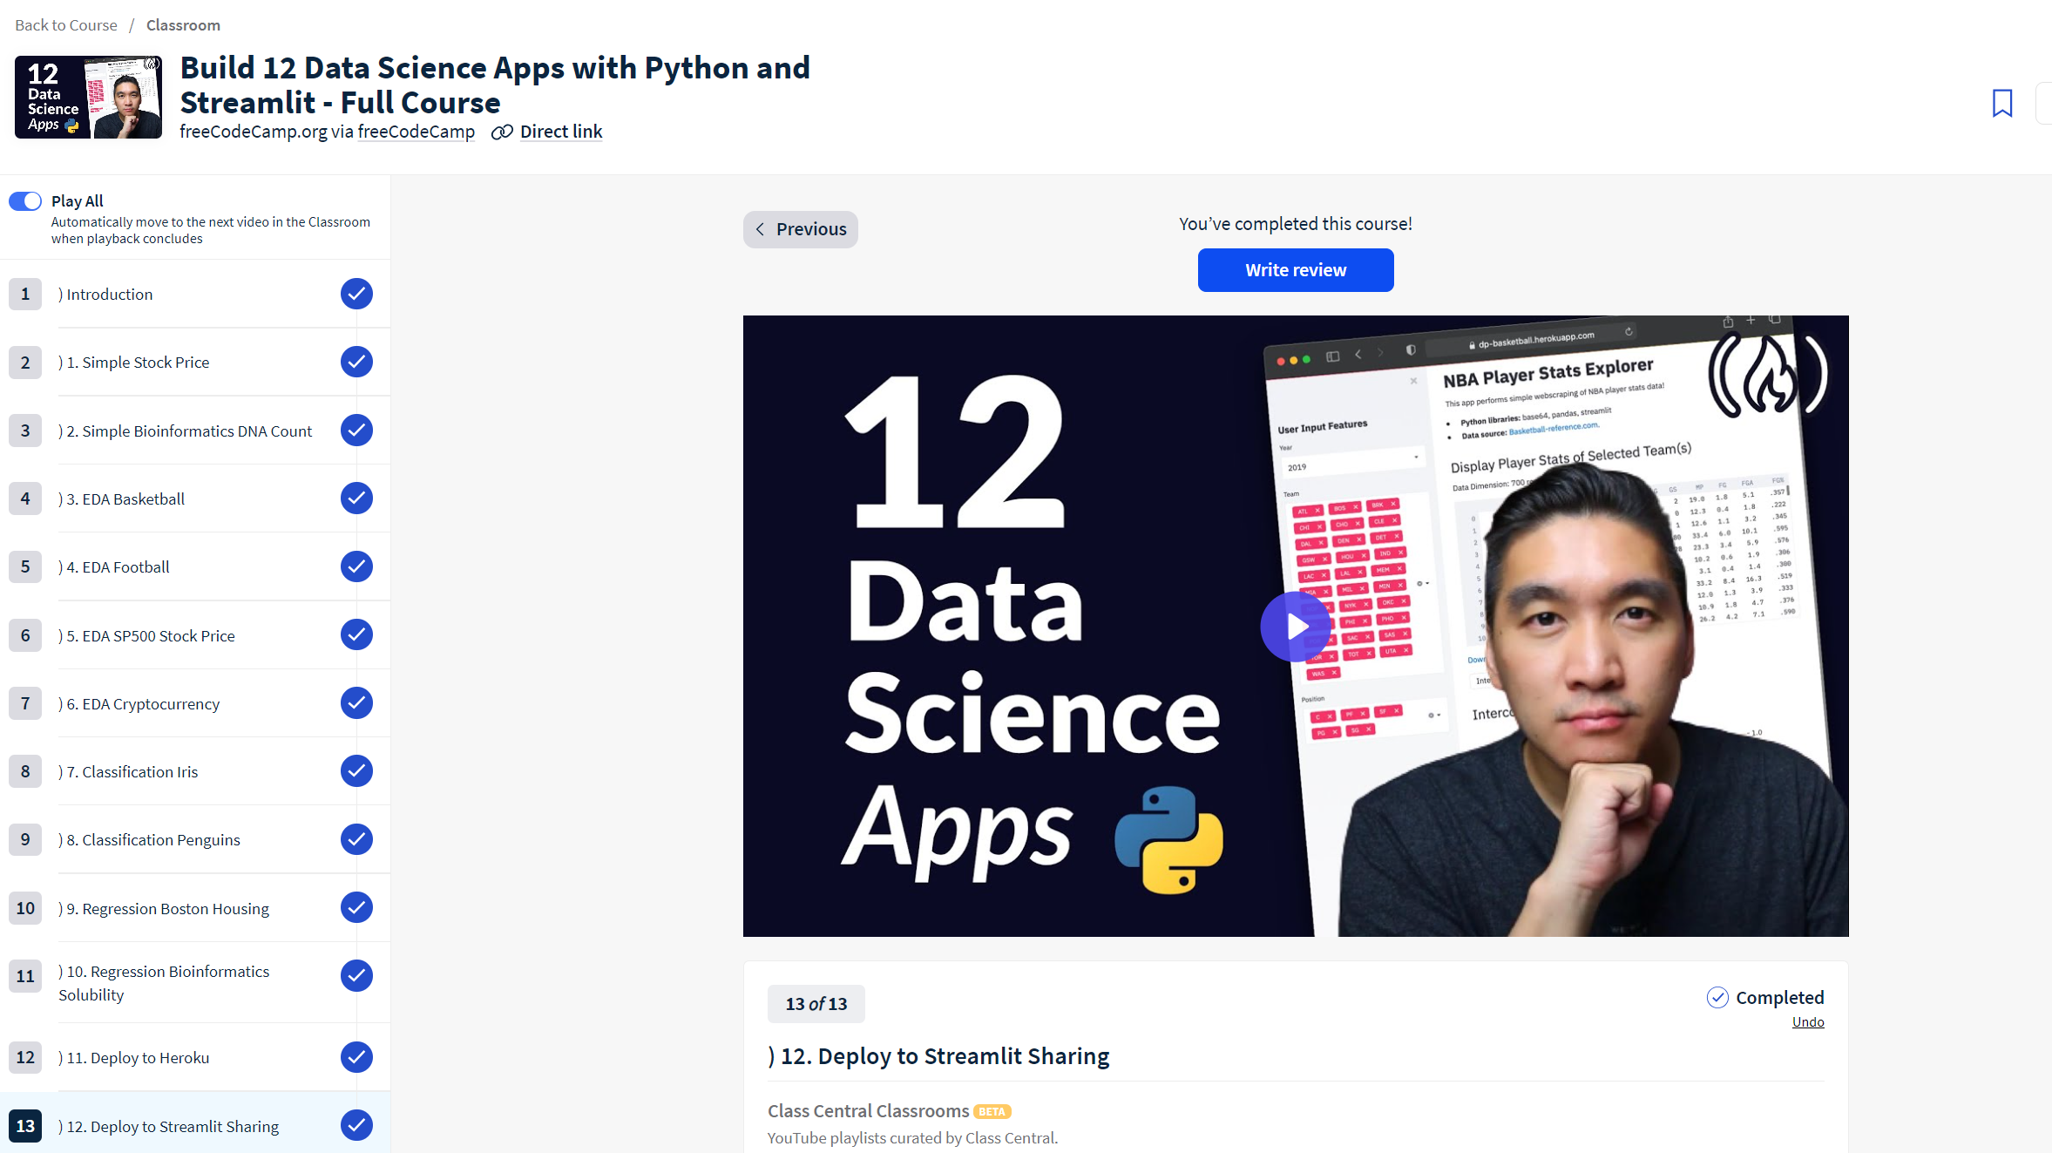
ILO 2
Personal Development & Academic Practice
Demonstrate self-exploration and personal development, good academic practices in learning how to learn and the acquisition of professional knowledge through research,
study, analysis, applied practice, discussion and reporting
2/6
2.0
Regularly engages in self-guided study and self-development, including active engagement in professional learning communities, studying online resources and active participation in (online) communities.
Streamlit app:
I completed a comprehensive course titled "Streamlit: Build Data Science Apps with Python" available on Class Central. Through 13 instructional videos, I gained the essential skills and knowledge necessary to develop effective Streamlit applications.
Moreover, I took the initiative to familiarize myself with the workings of the Streamlit website. This enabled me to upload Streamlit applications from to previous academic blocks (Year 1 Block D and Year 2 Block A) improving my LinkedIn account by showcasing my knowledge and presenting my projects in a better way. This process involved adapting the application code, creating a new GitHub repository, and generating a requirements file. As a result, anyone with the link can now access and run these applications on their computer.
Streamlit has proven to be a powerful tool, and I'm confident that the skills I've acquired will greatly benefit me in my future career.
Year 1 Block D : https://breda-municipality-safty.streamlit.app/
Year 2 Block A: https://projects-2024-2025-vje3z2mwxy42cxtjbt7ebm.streamlit.app/

Slide 32
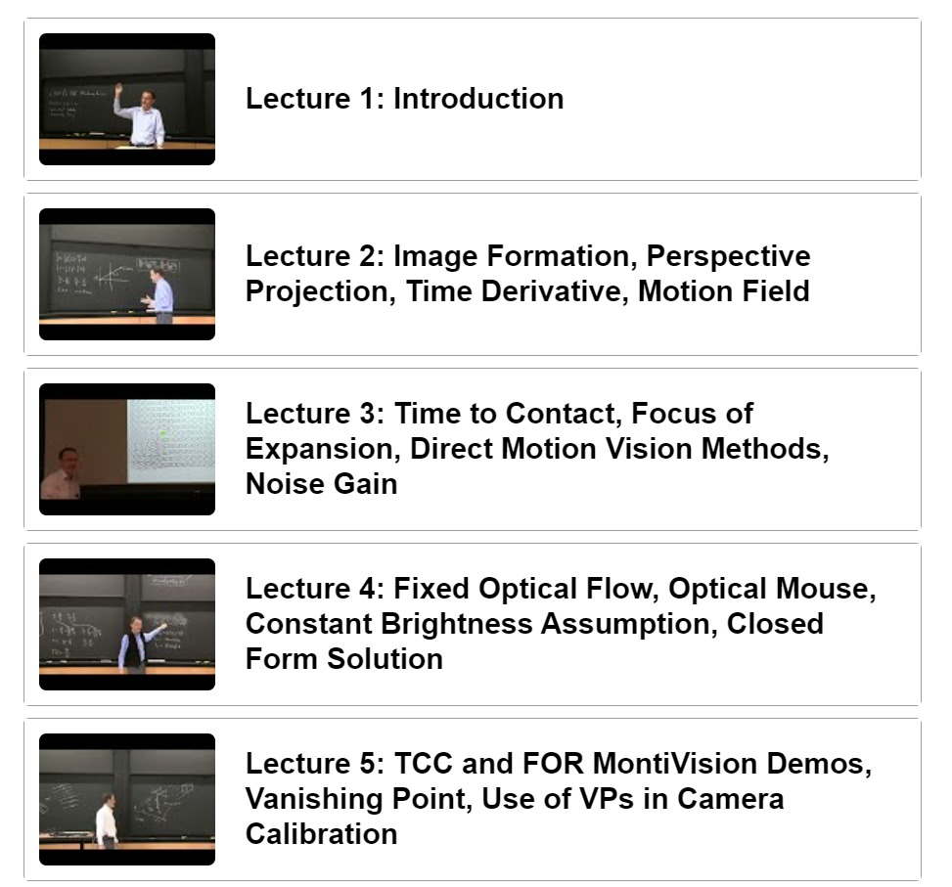
ILO 2
Personal Development & Academic Practice
Demonstrate self-exploration and personal development, good academic practices in learning how to learn and the acquisition of professional knowledge through research,
study, analysis, applied practice, discussion and reporting
2/6
2.0
Regularly engages in self-guided study and self-development, including active engagement in professional learning communities, studying online resources and active participation in (online) communities.
Machine Vision
I took a course on machine vision through MIT OpenCourseWare. Even though it was difficult, I did my best to understand the basics covered in the first five lectures, which included topics such as image formation, motion vision methods, and camera calibration. I watched some fragments more than once, trying to understand the topic, sometimes I reached for other sources to understand the issue. Through the learning process and active participation, I aimed to enhance my understanding of this complex subject and further my professional development in the field.
It was a good start, but in the future, I will continue working on this topic and aim to expand my knowledge in this area.
Course: https://ocw.mit.edu/courses/6-801-machine-vision-fall-2020/pages/syllabus/

Slide 33
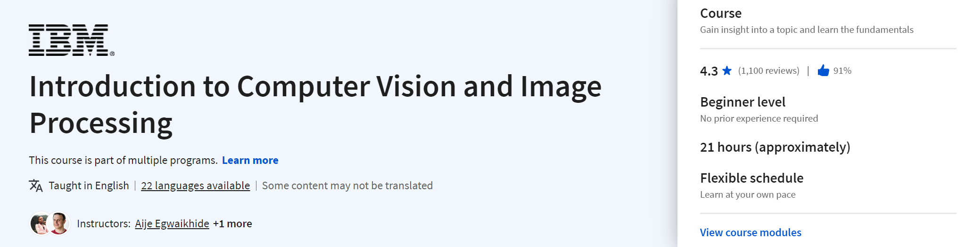
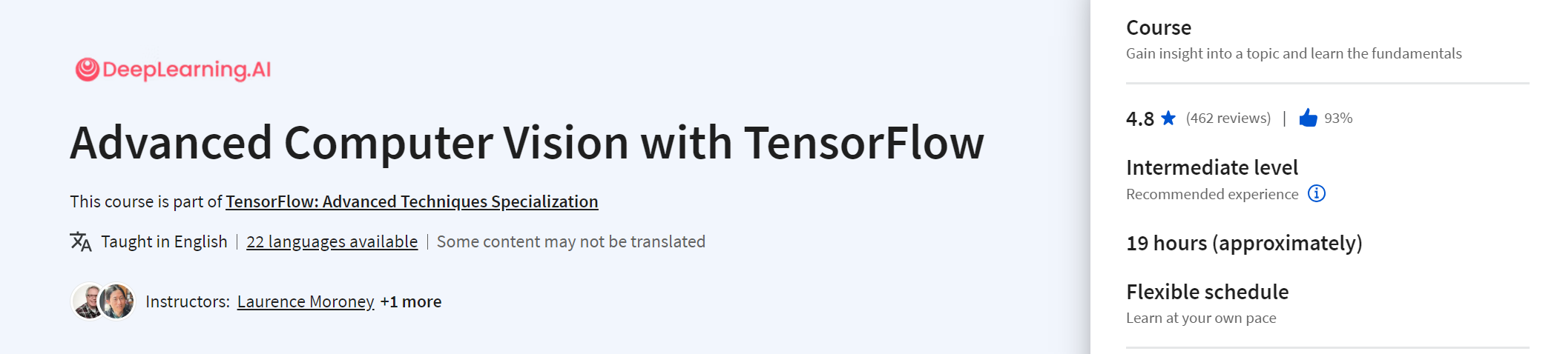
ILO 2
Personal Development & Academic Practice
Demonstrate self-exploration and personal development, good academic practices in learning how to learn and the acquisition of professional knowledge through research,
study, analysis, applied practice, discussion and reporting
2/6
2.0
Regularly engages in self-guided study and self-development, including active engagement in professional learning communities, studying online resources and active participation in (online) communities.
Computer vision:
I plan to do two computer vision courses. The first one teaches about computer vision basics and image processing. I'll learn how to use Python, Pillow, and OpenCV for simple image tasks and even create an image classifier.
The second course is more advanced, focusing on TensorFlow. I'll dive into object detection, image segmentation, and visualization. Both courses will help me understand computer vision better and improve my skills in this area.
Certificates : https://github.com/BredaUniversityADSAI/2023-24c-fai2-adsai-DominikSzewczyk224180/tree/main/Week%209-10%20challenges

Slide 34
ILO 3
3
Communication & Presentation
The student had a fair contribution to the teamwork and is able to explain the project processes and the outcomes.

Slide 35
ILO 3
Communication & Presentation
The student had a fair contribution to the teamwork and is able to explain the project processes and the outcomes.
3/6
3.0
The student is able to present their project together with the performance of their Kaggle submissions.
Show your best examples using GitHub links, do not go overboard, add in short description, you are free to alter this layout (or add slides per evidence) to suit your needs. Just be sure that it is clear.
The student is part of the final presentation and is able to explain one team Kaggle submission to an audience. Participates in the presentation workshops. | The student is able to describe the objective of the project. Moreover, the student is able to prepare a well-organized presentation with easy-to-read slides. Brings issues to the table during standup sessions when necessary. And meeting all criteria in poor. | The student exhibits knowledge of natural language processing by clearly explaining project details such as preprocessing, algorithms and evaluation. And meeting all criteria in insufficient. | The student is able to present and describe their best submission and at least two other submissions that led to the best submission, together with valid reasons for the iterations. Moreover, the student discusses whether the results of the iterations match their expectations. And meeting all criteria in sufficient. | The student is able to describe the best team submission and their personal contribution to it during the presentation. The student had a fair contribution to the quality of the teamwork by clear communication, evidenced by peer review. The student is able to provide constructive feedback to other groups during the final presentations. And meeting all criteria in good.
I actively participated in the final presentation, and I took part in the presentation workshops | I I can clearly describe the project's objective and create a well-organized presentation with slides that are easy to follow. During standup sessions, I make sure to bring up any issues that need addressing. | I can confidently explain project details like preprocessing, algorithms, and evaluation methods, showcasing my understanding of natural language processing. | I can present and describe my best submission along with at least two other submissions that contributed to its success, providing reasons for the iterations made. Additionally, I discuss whether the results of these iterations align with my expectations. | During the presentation, I can describe our team's best submission and my personal contribution to it. I believe I made a fair contribution to the quality of teamwork through clear communication, as indicated by peer reviews. Additionally, I am capable of offering constructive feedback to other groups during the final presentations.
Presentation: https://github.com/BredaUniversityADSAI/2023-24c-fai2-adsai-group-group2/blob/main/deliverables/Presentation_group2.pptx

Slide 36
ILO 4
4
Natural Language Processing
The student can pre-process linguistic data and is able to to develop natural language processing models.

Slide 37
ILO 4
Natural Language Processing
The student can pre-process linguistic data and is able to to develop natural language processing models.
4/6
4.1
The student is able to work with linguistic data and process the data in a manner that fits the project.
Show your best examples using GitHub links, do not go overboard, add in short description, you are free to alter this layout (or add slides per evidence) to suit your needs. Just be sure that it is clear.
https://github.com/BredaUniversityADSAI/2023-24c-fai2-adsai-DominikSzewczyk224180/tree/main/Natural%20Language%20procesing/Word%20embeddings
The student is able to preprocess text using regular expressions. The student completed all the content quizzes on Brightspace. | The student can apply tokenization and stemming to text data and completed all the Brightspace content quizzes with 60% correct or higher. And meeting all criteria in poor. | The student is able to extract sentiment and at least 2 more additional features free of choice from the data to use as input for a model. And meeting all criteria in insufficient. | The student can use word embeddings to represent words as vectors and use these embeddings in their machine learning models. The student demonstrates knowledge of TF-IDF and part-of-speech tagging evidenced by python code. And meeting all criteria in sufficient. | The student is able to create a word embedding model based on their own corpus and implement this in their machine learning models. And meeting all criteria in good.
I can preprocess text using regular expressions which is evidenced in Notebooks. I also completed all Brightspace quizzes. | I can apply tokenization and stemming to text data which is evidenced in Notebooks, and I completed all Brightspace quizzes with 80% correct or higher. | I extracted sentiment and 2 more additional features from the data used as an input for a model. | I can use word embeddings to represent words as vectors and I used these embeddings in my ML model. I demonstrated knowledge about TF-IDF and POS. Everything is evidenced in the links below. | I can create a word embedding model based on my own corpus and implement this to my machine learning model.
Features Extractions + POS tags: https://github.com/BredaUniversityADSAI/2023-24c-fai2-adsai-DominikSzewczyk224180/blob/main/Datasets/feature_extraction.ipynb
Word embeddings: https://github.com/BredaUniversityADSAI/2023-24c-fai2-adsai-DominikSzewczyk224180/tree/main/Natural%20Language%20procesing/Word%20embeddings
Notebooks: https://github.com/BredaUniversityADSAI/2023-24c-fai2-adsai-DominikSzewczyk224180/tree/main/Self-study/Notebooks
TF-IDF: https://github.com/BredaUniversityADSAI/2023-24c-fai2-adsai-DominikSzewczyk224180/tree/main/Natural%20Language%20procesing/TF-IDF

Slide 38
ILO 4
Natural Language Processing
The student can pre-process linguistic data and is able to to develop natural language processing models.
4/6
4.2
The student is able to develop natural language processing models.
The student can use naïve bayes and logistic regression algorithms to build a binary classification model for emotion classification. | The student can use statistical and neural models for building a classification model for emotion classification. And meeting all criteria in insufficient. | The student can use state-of-the-art NLP models including transformers as described in the project brief. And meeting all criteria in insufficient. | The student is able to create a pipeline using state-of-the art models for speech-to-text and apply emotion classification to the data. And meeting all criteria in sufficient. | The student can motivate the use of NLP models as described in the project brief and reflect on the best performing model considering the trade-off between accuracy, precision, recall and F1-score in an error analysis. And meeting all criteria in good.
I can use naïve bayes and logistic regression algorithms to build a binary classification model for emotion classification. | I can use statistical and neural models for building a classification model for emotion classification. I build Hidden Markov Model (HMM) and Conditional Random Fields (CRF), Recurrent Neural Network (RNN) and Long Short-Term Memory (LSTM). | I can use state-of-the-art NLP models including transformers as described in the project brief. I used transformer models for predicting emotions. | I created a pipeline that first splits video into fragments then gets text from this video and then predicts emotion for each fragment. | I can motivate the use of NLP models as described in the project brief and I reflect on the best-performing model considering the trade-off between accuracy, precision, recall and F1-score in an error analysis. Everything is evidenced in the Technical Report.
Naïve bayes: https://github.com/BredaUniversityADSAI/2023-24c-fai2-adsai-DominikSzewczyk224180/tree/main/Natural%20Language%20procesing/Na%C3%AFve%20Bayes
Transformer models: https://github.com/BredaUniversityADSAI/2023-24c-fai2-adsai-DominikSzewczyk224180/tree/main/Natural%20Language%20procesing/Transformer%20models
Logistic regression: https://github.com/BredaUniversityADSAI/2023-24c-fai2-adsai-DominikSzewczyk224180/tree/main/Natural%20Language%20procesing/Logistic%20Regression
Text to speech: https://github.com/BredaUniversityADSAI/2023-24c-fai2-adsai-DominikSzewczyk224180/tree/main/Natural%20Language%20procesing/Text_to_speach
Pipeline: https://github.com/BredaUniversityADSAI/2023-24c-fai2-adsai-group-group2/tree/main/src/Banijay_pipeline
Statistical & Neural Models: https://github.com/BredaUniversityADSAI/2023-24c-fai2-adsai-DominikSzewczyk224180/tree/main/Natural%20Language%20procesing/Statistical%20%26%20Neural%20Models
Technical Report:

Slide 39
ILO 5
5
Kaggle Natural Language Processing Competition
The student is able to compete at a Kaggle natural language processing competition individually and as part of a team.

Slide 40
ILO 5
Kaggle Natural Language Processing Competition
The student is able to compete at a Kaggle natural language processing competition individually and as part of a team.
5/6
5.0
The student is able to compete at a Kaggle natural language processing competition individually and as part of a team.
Show your best examples using GitHub links, do not go overboard, add in short description, you are free to alter this layout (or add slides per evidence) to suit your needs. Just be sure that it is clear.
The student is able to make an individual submission to a Kaggle competition for binary classification. | The student is able to make an individual submission to a Kaggle competition that improves upon previous submission(s). Moreover, the student is able to make a team submission. And meeting all criteria in poor. | The student is able to train a model that yields better results than minimal client requirements; makes at least 10 different submissions. And meeting all criteria in insufficient. | The student is able to reach the top 40% of the group leaderboard on a Kaggle competition and tracks their submissions; makes at least 15 different submissions. And meeting all criteria in sufficient. | The student is able to reach the top 20% of the group leaderboard on a Kaggle competition; makes at least 20 different submissions. And meeting all criteria in good.
I submit an individual submission to a Kaggle competition for binary classification. | I can create an individual submission for a Kaggle competition that improves upon previous submissions. Additionally, I am able to make a team submission. | My model achieved results well above the minimal criteria, demonstrating significant improvement. Additionally, I made a total of 21 submissions. | I reached the top 3 position in the Kaggle competition, and tracked and described 21 submissions. | I reached the top 3 positions in the Kaggle competition and made a total of 21 submissions, meeting the requirement to be in the top 20% of the group leaderboard.
Document with Submissions: https://github.com/BredaUniversityADSAI/2023-24c-fai2-adsai-DominikSzewczyk224180/blob/main/Datasets/Kaggle%20-%20Y2C_2023-24_ADSAI.xlsx

Slide 41
ILO 6
6
Technical Report: Natural Language Processing
The student can translate results into effective reporting.

Slide 42
ILO 6
Technical Report: Natural Language Processing
The student can translate results into effective reporting.
6/6
6.0
The student is able to write a technical report detailing model implementations and evaluations given a specific NLP task.
Show your best examples using GitHub links, do not go overboard, add in short description, you are free to alter this layout (or add slides per evidence) to suit your needs. Just be sure that it is clear.
The student can write a technical report for the client, with a word count between 3600 and 4400 words. | The student can provide an adequate overview and general explanation on the scope of the work. The student can explain the data processing steps and the report contains an EDA. Meeting all criteria in Poor. | The student includes technical information about their NLP model architectures and hyperparameter settings. The student is able to documented all of the sources used with appropriate citation styles. Meeting all criteria in Insufficient. | The student evaluates the performance of their implementations by reporting on suited metrics. The student is able to do an error analysis to explain model performance. Most of the sentences are well-written and free of grammar, punctuation, and spelling errors. Meeting all criteria in Sufficient. | The student can suggest concrete improvements to their solution and provides a critical discussion. The student can write a report where figures, tables and equations are clearly and logically identified and strongly support the text; all paragraphs are well-organized; use of sections is logical and allows easy navigation through the document. Meeting all criteria in Good.
I wrote a technical report for the client, and it meets the word count criteria. | I provided an adequate overview and general explanation of the scope of the work in my report. Additionally, I thoroughly explained the data processing steps and included an Exploratory Data Analysis. | I included technical information about my NLP model architectures and hyperparameter settings in the report. Furthermore, I ensured that all sources used were properly documented with appropriate citation styles. | I evaluated the performance of my implementations by reporting on suitable metrics in the report. Additionally, I conducted an error analysis to explain model performance. Most of the sentences in the report are well-written and free of grammar, punctuation, and spelling errors. | I suggested concrete improvements to my solution and provided a critical discussion in the report. Additionally, I ensured that figures, tables, and equations were clearly and logically identified and strongly supported the text. All paragraphs were well-organized, and the use of sections was logical, allowing easy navigation through the document.
Technical report: https://github.com/BredaUniversityADSAI/2023-24c-fai2-adsai-group-group2/blob/main/deliverables/Technical_Report_group2.pdf

Slide 43

Medal Challenges
Going the extra mile!

Slide 44
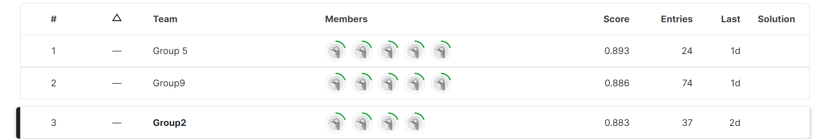
Medal Challenges
Going the extra mile!
1/1
Put your evidence down here to receive a medal!
My team achieved top-3 position in the Kaggle leaderboard (group).

Slide 45
Section D
D
Reflection
Notes:
MUST BE COMPLETED IN WEEK 8
Summative reflection on your progress during the block including a critical assessment of everything you did and learned during the block. This is a comprehensive review of everything recorded in Section B, evaluated against the goals and planning laid out in Section A.

Slide 46
D
What did I achieve this block?
1/2
My most significant achievements this block
My biggest achievement this block was making a model that predicts multi-class emotions. It reached the top 3 in the overall Kaggle leaderboard. Also, all the top 6 submissions in my group were mine. My model got a score of 0.883 on the private leaderboard, almost getting to the top 2 by just 0.003. This is my most significant achievement this block.
My most difficult challenges this block
My most difficult challenge this block was building the HMM model. I had to read many articles, but even after that, my model didn't want to work. I persisted, working hard to solve errors and finally get the model to learn and make predictions. Eventually, I succeeded. Despite the model not performing as well as I hoped, I was still happy about its progress.
The most important lessons I learned
The most important lesson I learned is the value of determination and staying focused on the goal. While creating submissions for Kaggle competitions, I encountered challenges with low scores initially. However, by continuously testing different models, adjusting parameters, and fine-tuning, I eventually achieved my goal and produced accurate predictions.

Slide 47
D
How well am I progressing?
2/2
Reflection on my self assessment My self assessment grade is a
10
Reflecting on my self-assessment, I gained valuable knowledge about NLP by completing all self-study materials, notebooks, and tasks required to finish the project successfully. Additionally, I actively collaborated with my team to create the best possible project. I maintained regular work habits, ensuring that all my logs were up to date. During feedback sessions, I consistently received positive feedback.
How I plan to improve next block
To improve in the next block, I plan to start filling out section C of my learning log earlier, rather than waiting until the last two weeks of the block. I believe this will help me with better planning and provide clarity on what I should focus on. By doing so, I can allocate my time more effectively and ensure that I meet each requirement

Slide 48
ILO 4
Natural Language Processing
The student can pre-process linguistic data and is able to to develop natural language processing models.
4/6
4.1
The student is able to work with linguistic data and process the data in a manner that fits the project.
RETAKE - Second Attempt
The student is able to preprocess text using regular expressions. The student completed all the content quizzes on Brightspace. | The student can apply tokenization and stemming to text data and completed all the Brightspace content quizzes with 60% correct or higher. And meeting all criteria in poor. | The student is able to extract sentiment and at least 2 more additional features free of choice from the data to use as input for a model. And meeting all criteria in insufficient. | The student can use word embeddings to represent words as vectors and use these embeddings in their machine learning models. The student demonstrates knowledge of TF-IDF and part-of-speech tagging evidenced by python code. And meeting all criteria in sufficient. | The student is able to create a word embedding model based on their own corpus and implement this in their machine learning models. And meeting all criteria in good.
I can preprocess text using regular expressions which is evidenced in Notebooks. I also completed all Brightspace quizzes. | I can apply tokenization and stemming to text data which is evidenced in Notebooks, and I completed all Brightspace quizzes with 80% correct or higher. | I extracted sentiment and 2 more additional features from the data used as an input for a model. | I can use word embeddings to represent words as vectors and I used these embeddings in my ML model. I demonstrated knowledge about TF-IDF and POS. Everything is evidenced in the links below. | I can create a word embedding model based on my own corpus and implement this to my machine learning model.

Slide 49
ILO 4
Natural Language Processing
The student can pre-process linguistic data and is able to to develop natural language processing models.
4/6
4.1
The student is able to work with linguistic data and process the data in a manner that fits the project.
RETAKE - Second Attempt
Regular expressions: https://github.com/BredaUniversityADSAI/2023-24c-fai2-adsai-DominikSzewczyk224180/blob/main/Self-study/Notebooks/W1-DL1-Regular-Expressions-Student-Notebook.ipynb
Tokenization and stemming: https://github.com/BredaUniversityADSAI/2023-24c-fai2-adsai-DominikSzewczyk224180/blob/main/Self-study/Notebooks/W1-DL2-Tweet-Processing-Student-Notebook.ipynb
Notebooks: https://github.com/BredaUniversityADSAI/2023-24c-fai2-adsai-DominikSzewczyk224180/tree/main/Self-study/Notebooks
Features Extractions + POS tags: https://github.com/BredaUniversityADSAI/2023-24c-fai2-adsai-DominikSzewczyk224180/blob/main/Datasets/feature_extraction.ipynb
TF-IDF: https://github.com/BredaUniversityADSAI/2023-24c-fai2-adsai-DominikSzewczyk224180/blob/main/Natural%20Language%20procesing/TF-IDF/TF-IDF.ipynb
Word embeddings: https://github.com/BredaUniversityADSAI/2023-24c-fai2-adsai-DominikSzewczyk224180/tree/main/Natural%20Language%20procesing/Word%20embeddings
Create_Word_Embeddings_Task8.ipynb: https://github.com/BredaUniversityADSAI/2023-24c-fai2-adsai-DominikSzewczyk224180/blob/main/Natural%20Language%20procesing/Word%20embeddings/Create_Word_Embeddings_Task8.ipynb
Implement_Word_Embeddings_Task5.ipynb: https://github.com/BredaUniversityADSAI/2023-24c-fai2-adsai-DominikSzewczyk224180/blob/main/Natural%20Language%20procesing/Word%20embeddings/Implement_Word_Embeddings_Task5.ipynb

